Slide 1
Rebuilding the Interproximal Papilla: Description of “Tube” Technique and Two Case Reports
Guided By: Presented By:
Dr. P. Suresh, K. Latha,
Prof & Hod, Pg Student.
Department Of Periodontics.

Slide 2
CONTENTS
INTRODUCTION
CLASSIFICATION
ETIOLOGY
TREATMENT
CASE SELECTION AND PRESENTATION
CLINICAL OUTCOMES
DISCUSSION
KEYS FOR SUCCESSFUL MANAGMENT OF THESE CASES
LIMITATIONS
CONCLUSION
REFERENCES

Slide 3
INTRODUCTION
Interdental papillae occupy the space between adjacent teeth and form part of the gingivae.
Deficient interdental papillae cause open embrasures, which lead to various issues, such as esthetic problems, phonetic problems, and food impaction.
The appearance of the papillae is an important issue in gingival esthetics. Esthetically, the ultimate goal is to achieve a “white and pink” esthetic.

Slide 4
“White” refers to the adjacent teeth, and “pink” refers to the interproximal gingival tissue.
A survey by Naorungroj et al suggested that a black triangle of 2 mm in size may be noticed by lay people, and a black triangle of 3 mm is considered unattractive.

Slide 5
Food impaction caused by deficiency in interdental papillae also induces dental plaque accumulation and also causes discomfort, but also leads to adverse oral conditions, such as bad breath, root caries, and gingivitis.
In addition, when interdental papillae are missing, the open embrasure provides space for air or saliva, which is the main cause of phonetic problems.
The concept of an “interdental papillae house” has been proposed to describe the relationship between soft tissue and hard tissue surrounding the interdental papillae.

Slide 6
The concept likens the interproximal space containing the interdental papillae to a house, which includes the contact area, cementoenamel junction (CEJ), tooth surface, and area where the root and soft tissue converge above the alveolar bone crest.
The reconstruction of deficient interdental papillae is one of the most difficult and least predictable problems to address.
Various treatments aim to reconstruct interdental papillae by surgical or nonsurgical approaches.

Slide 7
Surgical procedures aim to reconstruct or preserve the gingival tissue by using a soft tissue flap or soft tissue augmentation.
However, because of the narrowness and limited blood supply of interdental papillae, predictable outcomes are difficult to achieve by means of surgical procedures.
Therefore, surgical procedures are more suitable for deficient interdental papillae that involve a bone defect or a large amount of soft tissue loss.

Slide 8
Nonsurgical procedures remodify the embrasure space to ensure that the papillae are tissue filling.
Minimally invasive approaches include nonsurgical procedures and emerging procedures that involve less trauma, for example, laser or injection treatments.
These methods, such as restorative techniques, orthodontic movement to reshape and decrease open embrasures, and reconstruction of interproximal gingival tissue, are increasingly used in the clinic.

Slide 9
CLASSIFICATION OF DEFICIENT INTERDENTAL PAPILLAE
A convenient and widely accepted classification of deficient interdental papillae is beneficial for studying this phenomenon and for standardizing clinical cases.
Nordland and Tarnow classified interdental papillae by considering the CEJ and the interdental contact point as references.

Slide 10
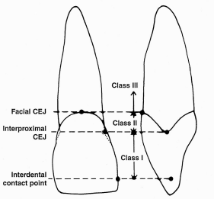

Slide 11
Normal. Interdental papilla fills embrasure space to the apical extent of the interdental contact point/area.
Class I. The tip of the interdental papilla lies between the interdental contact point and the most coronal extent of the interproximal CEJ (space present but interproximal CEJ is not visible).
Class II. The tip of the interdental papilla lies at or apical to the interproximal CEJ but coronal to the apical extent of the facial CEJ (interproximal CEJ visible).
Class III. The tip of the interdental papilla lies level with or apical to the facial CEJ.

Slide 12
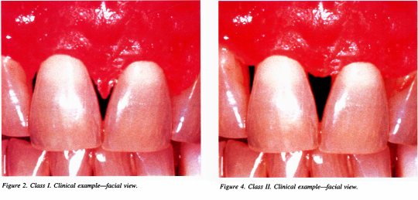
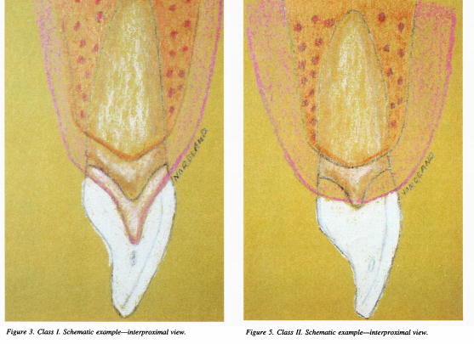

Slide 13
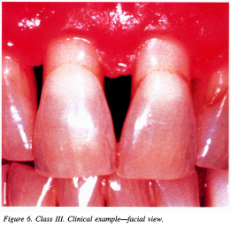
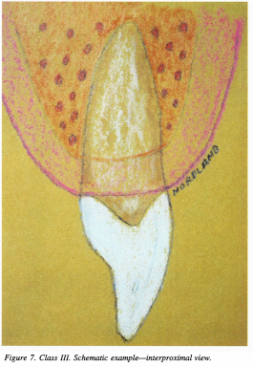

Slide 14
In consideration of the absence of an interdental contact point in some cases, Cardaropoli et al made another system to assess interdental papillary level.
This classification considered the CEJ and adjacent teeth as references to measure the soft tissue level.

Slide 15
Papilla Presence Index (PPI)
PPI Score 1: is reported when the papilla is completely present and coronally extends to the contact point to completely fill the interproximal embrasure. This papilla is at the same level as the adjacent papillae.
PPI Score 2: describes a papilla that is no longer completely present and lies apical to the contact point. This papilla is not at the same level as the adjacent papillae, and the embrasure is no longer completely filled, but the interproximal CEJ (iCEJ) is still not visible.
Both PPI 1 AND PPI 2 scores can be complicated by the presence of buccal gingival recession, classified as PPI 1r and PPI 2r.

Slide 16
PPI Score 3 refers to the situation in which the papilla is moved more apical and the iCEJ becomes visible. This situation is compatible with a great amount of interdental soft tissue recession.
PPI Score 4 describes when the papilla lies apical to both the iCEJ and buccal CEJ (bCEJ). Interproximal soft tissue recession is present together with buccal gingival recession, and patient esthetics is dramatically compromised.

Slide 17
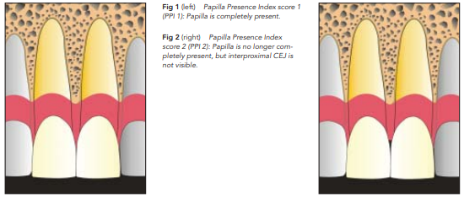
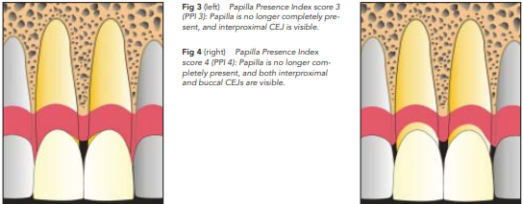

Slide 18
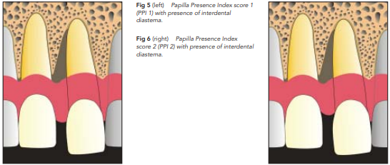
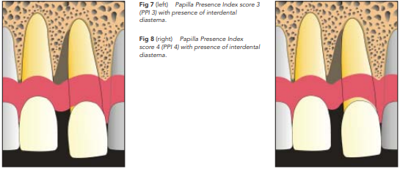

Slide 19
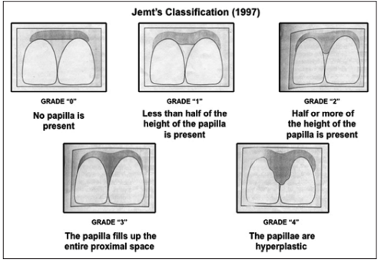
Contour of interdental papilla:

Slide 20
ETIOLOGY
Distance between the bone crest and the base of the contact area (BC-CA) is considered to be the main contributor to the presence of interdental papillae.
A survey by Tarnow et al indicated that, when the BC-CA distance was less than 5 mm, the papillae occupied 98% of the interproximal space, while when the distance was more than 7 mm, the papillae represented no more than 27% of the space.
The influence of the BC-CA distance on the interdental papillae increases with increasing age.

Slide 21
Kolte et al found that, when the BC-CA distance was less than 4 mm, there was an 87% chance of interdental papillae being present.
When the distance was 6 mm, this chance decreased to 41.1%. The likelihood of interdental papillae being present decreased as the distance increased.
In addition, in some sites, the BC-CA distance had a different influence on the presence of interdental papillae, and the maxillary central papillae seemed less sensitive to the increase in BC-CA distance than were the lateral papillae.

Slide 22
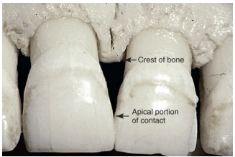
The central papillae may still occupy most of the interproximal space until the BC-CA distance reaches 8 mm, while the lateral papillae could not fill the space when the BC-CA distance exceeded 5 mm.

Slide 23
The length and height of the interproximal contact area between teeth determine the size of the interproximal space that accommodates the interdental papillae.
Kolte et al studied the proximal contact area and the proportion of the proximal contact area of the crown, and found that both of these were decreased from the maxillary central incisor to the first molar on both sides.
This study suggested a close relationship between these factors and the presence of interdental papillae.

Slide 24
The study by Chow et al also proved that a larger interproximal contact area increased the possibility of a complete interdental papilla.
However, the study by de Santana et al suggested that the interproximal contact area has little influence on the presence of interdental papillae.
Therefore, more evidence is needed to verify the relationship between the interproximal contact area and interdental papillae.

Slide 25
Interproximal root distance
As the root distance increased, the likelihood of the presence of the interdental papillae decreased.
A study by Kolte et al suggested that the likelihood of interdental papillae existing was 78.5% when the root distance was 0.5 to 1 mm, but decreased to 75.6% when the distance increased to 1 to 1.5 mm.
When root distance became greater than 1.5 mm, but was less than 2 mm, there was a 56.7% probability of interdental papillae existing.

Slide 26
The study also showed that root distance had a greater influence on the existence of interdental papillae when the vertical distance from the alveolar crest to the base of the contact area was 5 mm.
Cho et al investigated interdental papillae in 80 patients and found that, when the root distance was 1 mm, interdental papillae were present in 72.4% of the cases; however, when the root distance was 3.5 mm, interdental papillae were present in only 6.3% of the cases.

Slide 27
Root angulation
The divergence of roots is another factor associated with interdental papillae.
A large divergence angle can stretch the transseptal fiber, which promotes an interproximal open embrasure.
Kurth et al reported that the divergence angle is 3.65° for the normal condition of interdental papillae, and that the chance of an open embrasure increased to 14% to 21% for a 1° increase in the divergence angle.

Slide 28
Crown contour
The appearance of the maxillary central papillae is a frequent topic of analysis and carries great weight in esthetic treatment plans.
The shape of teeth, particularly of the maxillary central incisor, influences the presence of interdental papillae.
On the basis of the ratio of the tooth crown width and length, the shape of the central incisor is divided into three types: triangle, square-tapered, and square.

Slide 29
Among these three shapes, the square shape has the largest interproximal contact area, and the interproximal space is also the smallest, whereas the triangle shape has the smallest interproximal contact area; therefore, triangular crowns require more gingival tissue to fill the interproximal space.
In addition, with a square-shape crown, a shorter interdental papilla is more likely.

Slide 30
Biotypes
Gingival thickness is a critical factor that influences the presence of interdental papillae, and also affects interdental papilla reconstruction.
As it is supported by a larger area of keratinized tissue, thick alveolar bone structure, and increased blood supply, thick gingival tissue has better resistance than thin gingival tissue against external stimulation or gingival inflammation.
A thick biotype is defined as having a gingival tissue thickness ≥ 2 mm, while a thin biotype is defined by a gingival tissue thickness of < 1.5 mm.

Slide 31
Generally, a thick biotype is usually associated with flatter and shorter interdental papillae and has less opportunity to form an open embrasure.
A thin biotype is more likely to have a shorter interdental papillary height and an open embrasure when the distance between the contact area and the alveolar crest is increased.
Barboza de Lemos et al suggested that, when the distance between the alveolar bone and the contact point was 6mm, interdental papillae were more likely to exist among those with the thin biotype.

Slide 32
Age
There was a positive relationship between the height of interdental papillae and age.
Chang showed that the oral epithelium is thinner with increasing age, while bone volume, aging, and traumatic oral hygiene were also the causes of interdental papillae deficiency.

Slide 33
Orthodontic therapy
Orthodontic treatment could lead to deficient interdental papillae, particularly in the case of overlapped teeth.
Burke et al showed that 41.9% of maxillary central incisors had an open gingival embrasure after orthodontic treatment.
Jeong et al suggested that, after dentition was regularly arranged, maxillary central interdental papillae were 0.8 mm shorter, on average.
This dilemma may be due to the alveolar bone absorption caused by orthodontic treatment, an inappropriate bracket position, or an increase in the length of the tooth crown.

Slide 34
Treatment
Various non-surgical and surgical techniques have been introduced with the sole intension of either reconstruction or regeneration of the lost papilla either by modifying the interproximal spaces or by surgical reconstruction of the lost soft tissue between the teeth.
The non-surgical approach (orthodontic, prosthodontics, restorative) modify the interproximal space, thereby inducing modifications of the soft tissues.
Most of the surgical procedures have emphasized gingival grafting.

Slide 35
Non-surgical approach:
Correction of traumatic oral hygiene
Restorative and Prosthetic approaches
Orthodontic approach
Repeated Scrapping of the Papilla
Tissue Volumizing
Minimally Invasive approach:
Reshaping interproximal area
Laser
PRP

Slide 36
Surgical approach:
Papilla recontouring – gingivectomy.
Papilla reconstruction – Beagles technique (1992),
Han and Takie 1996,
Azzi et al. 1998.
Papilla preservation - Conventional PPF,
Modified PPF,
Simplified PPF,
Whale’s tail technique.

Slide 37
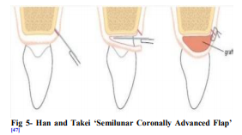

Slide 38
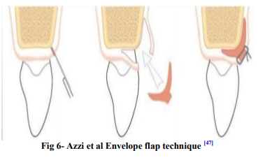

Slide 39
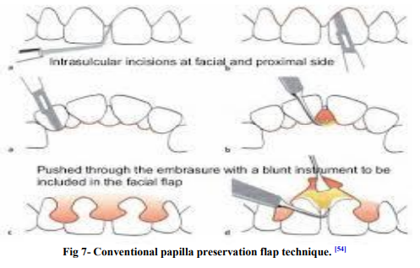

Slide 40
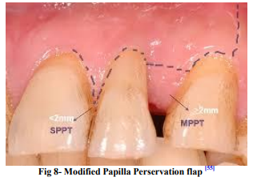

Slide 41
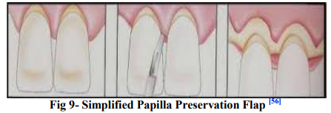

Slide 42
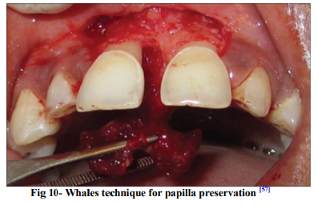

Slide 43
Clinical Selection and Presentation
Inclusion criteria:
Individuals who were healthy, that is,
free of any systemic diseases,
non-smoking adults with attachment loss (AL) of 5 mm or less from the contact point were selected, and
verbal consent was obtained for this procedure.
Neither had any scar tissue at the recipient or surgical site.

Slide 44
Exclusion criteria:
Anatomical groves, carious lesions, and shallow vestibular depth are other anatomical factors that are contraindications for this procedure.
Also, patients with poor oral hygiene and oral habits are not good candidates for the tube technique.

Slide 45
Both cases reported to the author’s Hooshang Kashani (HK) private practice for treatment of recession between #7 and #8.
Case 1 was a 31-year-old female who reported to Campbell Dental Group, Campbell, CA, with recession due to local factors (plaque and calculus).
Case 2 was a 27-year-old female who reported to the Fremont Dental Group, Fremont, CA due to surgical removal of a benign tumor 2 years prior.

Slide 46
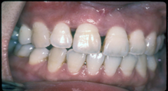

Slide 47
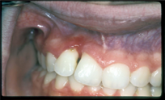
Similarly, in Case 2, the presence of bleeding on probing in the region apical to the recession was present.
The recession was 5 mm deep and 5 mm wide with AL of 5 mm in the interdental papilla, which was classified as Class III based on the Nordland and Tarnow classification system.
Pre- and postoperative photographs of both cases are attached.

Slide 48
Case Management
For surgical preplanning, study models were used to verify the dimensions of the recession defect.
When administering local anesthesia, care was taken to avoid injecting directly into the recipient site.
To cleanse the exposed root surfaces, saturated citric acid was applied to the roots using a small micro brush.
Using a #15 blade, a semilunar incision was placed on the buccal aspect at the level of the mucogingival junction and a full-thickness flap was elevated.

Slide 49
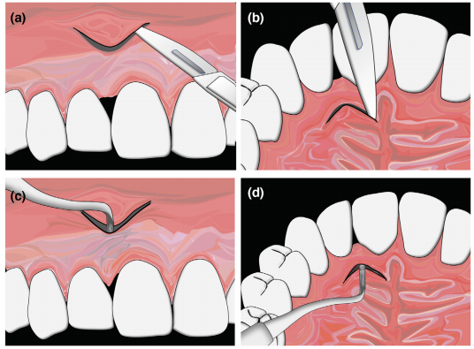

Slide 50
The flap was extended mesio-distally by an additional 4 to 5 mm than needed for the graft. This extension allowed the buccal flap to be freely moved into the recession area.
Another semilunar incision was placed on the palatal aspect, such that the zenith of the incision was located proximal to the alveolar crest.
An excavator (smaller than the width of the defect; evaluated pre-surgically on a study model) was used to carefully reflect the papilla away from the alveolar bone and root surfaces on the buccal aspect to access the interproximal region to prepare the bed for the graft. The excavator was used to do the same on the palatal aspect.

Slide 51
The amount of reflection should yield a very relaxed papilla flap that permits placement of the papilla at the new coronal position without tension.
The recipient site at this time should resemble a “tube” with two openings; one on the buccal aspect at the mucogingival junction and one on the palatal aspect.
Sounding with a periodontal probing was used to ensure a minimum 3 mm of tissue thickness and to map the precise location of the donor area.

Slide 52
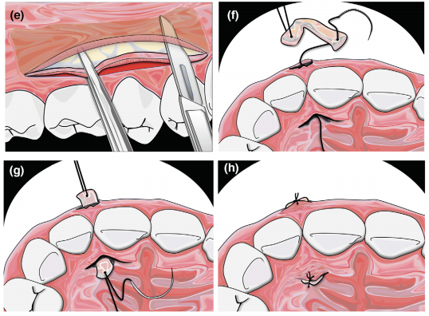

Slide 53
To harvest the graft, the incision was made parallel to and 2 mm away from the gingival margin.
A thin flap containing the keratinized tissue was separated, then the second incision was made parallel to the gingival margin, but perpendicular to the alveolar bone.
With a sharp periosteal elevator, the graft was raised with the periosteum and released at its anterior and posterior ends, and then from its base.
The harvested graft was larger than the interproximal defect in both cases: each graft was 12 to 15 mm long, 5 mm wide, and 2 mm thick.

Slide 54
A 4.0 chromic gut suture was used to pass the eye (swage) of the needle into the tube from the palate toward the buccal.
The suture needle then engaged one end of the graft.
An additional separate second suture was placed on the other end of the CT graft.
One suture end (eye first) was passed through the tube toward the palatal side.

Slide 55
The connective tissue graft was carefully slipped through the buccal aspect of the tube into the prepared interproximal bed towards the palate by means of the suture with the assistance of a periosteal elevator as needed.
The thickest part of the graft was placed in the interproximal area.
The connective graft was sutured under the flaps onto the buccal and palatal tissues and the buccal and palatal flaps were sutured over the top of the graft.
The size of the needle does not matter for this procedure; 4-0 silk was used with an FS2 cutting needle and a 4-0 chromic gut suture with a C-6 (FS-2) cutting needle.

Slide 56
Using the index finger and thumb the graft was squeezed from both ends inward for at least 4 to 5 minutes to further stabilize the graft into position.
Both patients were instructed to avoid brushing or flossing the recipient as well as donor site.
They were also asked to avoid hot, chewy, sticky foods.
They were advised to ice the wound to reduce post-surgical swelling.

Slide 57
Clinical Outcomes
Healing was uneventful at both the donor and recipient sites in both cases.
A net gain of 5 mm was noted in Case 1 and 4 mm in Case 2; measured one year post-surgically.
Patient evaluation for Case 1 was performed at 1 week, 4 weeks, and 1 year after surgery, and for Case 2 at 7 weeks and 1 year after the procedure.

Slide 58
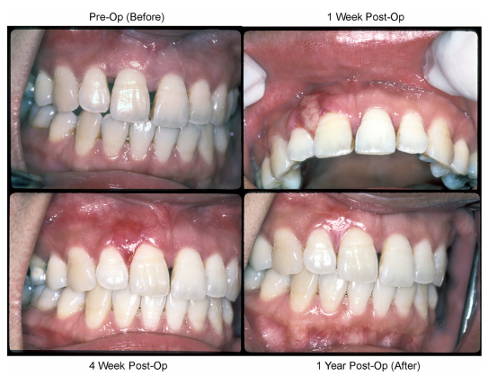
Case 1

Slide 59
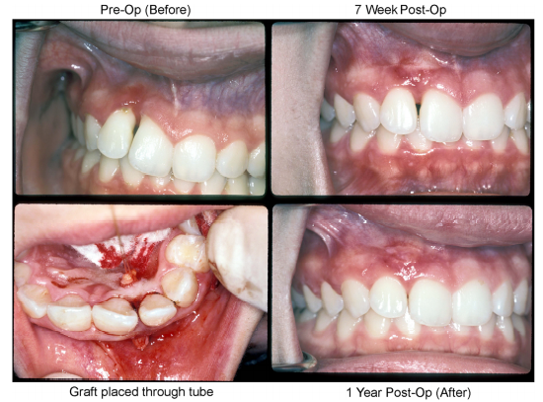
Case 2

Slide 60
DISCUSSION
In 1988, one of the first techniques for treating interproximal recession was introduced.
This technique involved creating space by flapping interproximal and buccal areas using horizontal incisions to raise a flap to accommodate a connective tissue graft.
However, just one out of three cases achieved complete coverage.

Slide 61
In 1999, two modifications of this technique were introduced.
One procedure used a semilunar incision to rebuild the papilla. They folded the connective tissue graft and achieved coverage in 50% of the cases studied.
The other modification used three incisions to release a pedicle flap from the incisive papillary area but did not achieve predictable coverage in the recession area either.

Slide 62
The disadvantages of these techniques are the number and location of incisions, which can disrupt the blood supply needed for complete healing and for the graft to take.
The tube technique does not disturb the blood supply of the graft by its use of apical incisions and containment of the graft within a rich vascular enclosed bed, thereby offering reliable and satisfactory results.

Slide 63
Integrity of the soft tissue is key to the successful outcome of this technique.
This procedure is not recommended in cases where the recipient area has scar tissue.
Another critical factor for success is the thickness of the donor tissue.

Slide 64
A sounding technique should be used to evaluate the relative thickness of the tissue at the donor site, such as the posterior hard palate, edentulous ridge, or maxillary tuberosity.
More advanced techniques, such as use of computerized tomography may be useful for this purpose.

Slide 65
An adequate size graft can be obtained more readily for smaller areas of recession.
Thicker grafts are more likely to provide complete fill. The likelihood that the papilla will fill the interproximal space decreases as the alveolar crest to contact point distance increases beyond 5 mm.
Other important factors that affect success are the size of the graft and the size of the soft tissue defect.

Slide 66
Given the dimensional changes and shrinkage of soft tissue grafts, the size of the graft should be larger than the recipient site.
With respect to anatomical width of interproximal space, this procedure can be attempted for both broad base and narrow base interproximal spaces.

Slide 67
Local factors like anatomical grooves, carious lesions, contact area, embrasure space, flap design, flap mobilization, advancement, adaptation, and stabilization, shallow vestibular depth, and presence of scar tissue, and patient factors, like presence of systemic disease, such as diabetes, smoking, oral habits, and oral hygiene factors can also impact the success of soft tissue grafting procedures.

Slide 68
Keys To Successful Management Of These Cases
Maintaining an unrestricted blood supply at the recipient site
Selecting an appropriately thick donor tissue site
Selecting a graft that is larger than the defect of the recipient site.

Slide 69
LIMITATIONS
Requires technical precision
Sensitive to any surgical trauma and tension
Cannot be performed in presence of scar tissue at the recipient site

Slide 70
CONCLUSION
In summary, several local, patient, and surgical factors, including flap thickness, blood supply, and flap retraction impact the success of soft tissue grafting.
Recent data indicate that soft tissue thickness >_0.8 mm is needed for complete coverage. A dual blood supply is desirable and likely contributes to the increased success with use of subepithelial connective tissue grafts techniques.

Slide 71
Flap retraction and flap tension decrease the predictability of root coverage with subepithelial connective tissue grafts or coronally positioned flap techniques.
It requires technical precision & is sensitive to any surgical trauma and tension, especially when the recipient site tissue is delicate, so dedicating extra time and care is highly recommended.
The present paper discusses the use of the tube technique and its results in just two cases. An evaluation of this new technique through a larger study is warranted to confirm its predictability.

Slide 72
REFERENCES
Carranza’s; Clininal Periodontology – 13th edition.
Zhang Y, Hong G, Zhang Y, Sasaki K, Wu H. Minimally invasive procedures for deficient interdental papillae: A review. J Esthet Restor Dent. 2020;1–9.
Nordland WP, Tarnow DP. A classification system for loss of papillary height. J Periodontol. 1998;69(10):1124-1126.
Jamwal D, Kanade K, Tanwar VS et.al. Treatment of interdental papilla: a review. Galore International Journal of Health Sciences & Research. 2019; 4(2): 1-12.

Slide 73
Tarnow DP, Magner AW, Fletcher P. The effect of the distance from the contact point to the crest of bone on the presence or absence of the interproximal dental papilla. J Periodontol. 1992;63(12):995-996.
Cardaropoli D, Re S, Corrente G. The papillae presence index (PPI): a new system to assess interproximal papillary levels. Int J Periodont Restor Dent. 2004;24:488-492.
Sawai ML, Kohad RM. An evaluation of a periodontal plastic surgical procedure for the reconstruction of interdental papillae in maxillary anterior region: A clinical study. J Indian Soc Periodontol 2012;16:533-8.

